Slide 1
Cloud-based Transcription of Tamil Speech
Guide: Dr. A.Shahina
Sandeep S (185002086)
N.Srividhya (185002103)
Notes:
1
1
Explain what is transcription, translation and what it means about cloud based. Mention what is unique about out project . Tell about automatic speech recognition (imp) transcrition

Slide 2
Overview
Problem statement: Reliable and cost-effective transcription of Tamil speech
Solution approach
Build an ASR model for cost-effective transcription
Deploy model in cloud to enable global accessibility
Develop a website for convenient use of deployed model

Slide 3
Project Management

Slide 4
Tasks Undertaken
Developing Project Planning Timeline
Regular meetings with project mentor (every Saturday)
Assigning tasks to team members using Agile Story Board

Slide 5
Project Story Board

Slide 6
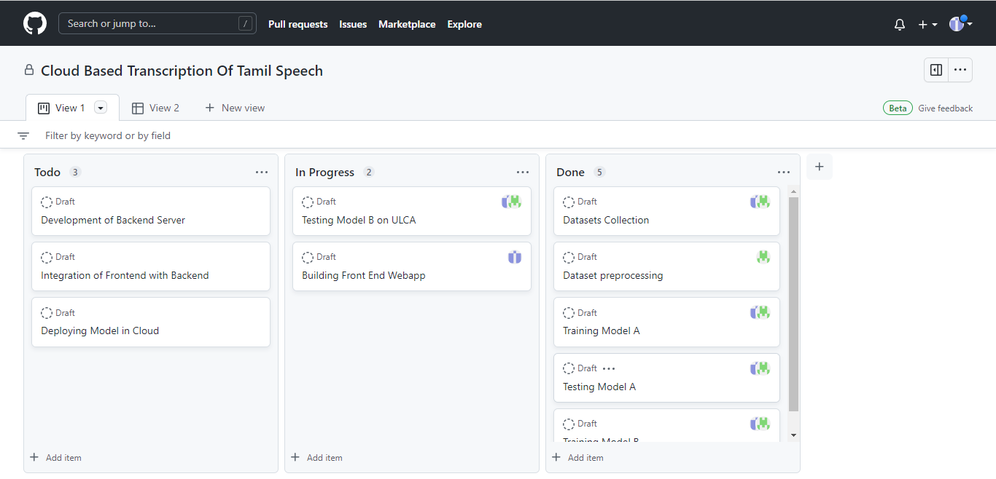

Slide 7
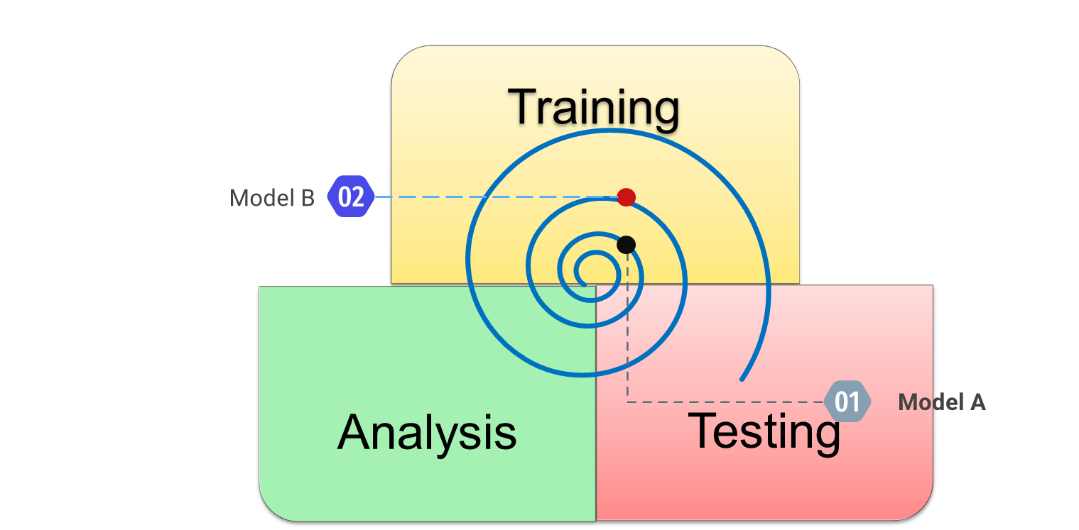
Model Build Lifecycle

Slide 8
Project Timeline
Oct 2021
Review 0
Review 1
Review 3
Problem definition
SoW estimation
Review 2
ASR Model v1
Language Model
Datasets finalization and pre-processing
09/04/22 – 12/04/22: Exploratory Analysis of ULCA Corpus
13/04/22 – 21/04/22: Testing of Model A on ULCA
21/04/22 – 23/04/22: Analysis of Test Results
23/04/22 – 02/05/22: Training of Model B
Apr 2022
Today

Slide 9
System Design
Dataset Preprocessing
ASR Model Training
Testing and Analysis
Deploying the Model in Cloud
Training AM
Building LM

Slide 10
Current Progress

Slide 11
Review 1 follow-up
Exploratory analysis of ULCA corpus
Testing of performance of Model A on ULCA
Analysis of test results
Development of Model B

Slide 12
Exploratory Analysis of ULCA Corpus

Slide 13
Model A Test Results

Slide 14
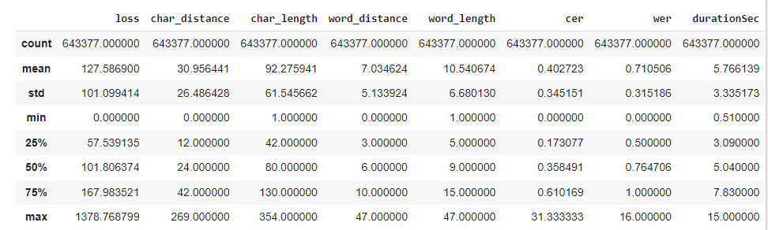
Overall Test Results

Slide 15
Domain-wise Test result analysis

Slide 16
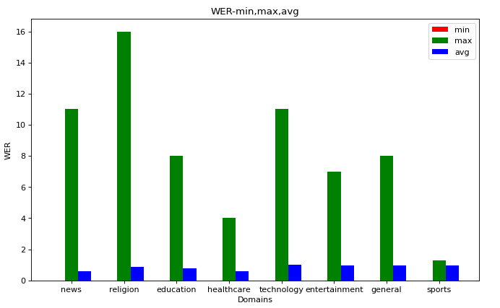

Slide 17
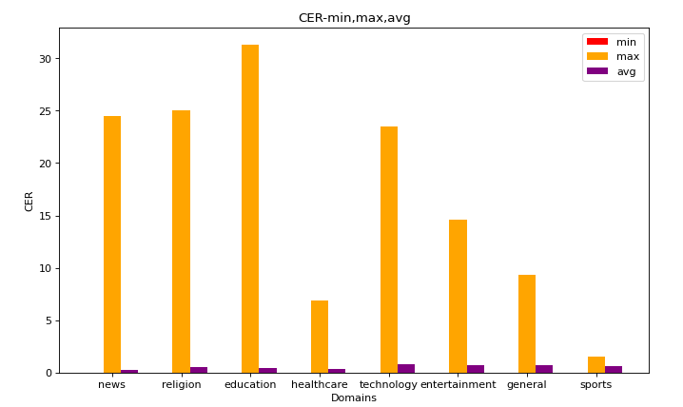

Slide 18
Strength of LM and AM

Slide 19
Statistics:
LM Data consists news related words in majority.
Domain | Count of Words in ULCA
News | 133974
Religion | 75663
Education | 57863
Technology | 31541
General | 21714
Entertainment | 16991
Sports | 3880
Healthcare | 12617

Slide 20
Statistics:
Words in Training dataset (AM data) consists news related words in majority
Domain | Count of Words in ULCA
News | 37838
Religion | 28975
Education | 24312
Technology | 11348
General | 9489
Entertainment | 7979
Sports | 1759
Healthcare | 6680

Slide 21
Total OOV Words not known to LM: 76.
Total OOV Words not known to AM: 1,16,107.

Slide 22
Conclusions from testing Model A
Model performs well for Tamil news as the rate of speech is controlled and generally noise-free.
Aided by LM trained on large amount of news articles
ULCA dataset has a wide variety of audio distributions not present in training datasets
Model performed poorly when exposed to real-time speech conditions like noise, rate of speech etc.
Need to make model more robust

Slide 23
Building ASR Model B

Slide 24
Dataset Selection
CommonVoice (195 hrs)
OpenSLR (7 hrs)
Model Training
Running train script with the processed datasets
Model Testing
Microsoft Open Research (45 hrs)
Saving final model after 36 epochs
Testing model performance on test-dataset and custom audio
Analysis of test results obtained
DeepSpeech Augmentation options selected: Pitch, tempo, loudness etc.
Notes:
Justify each step

Slide 25
Next Steps
Testing Model B on ULCA
Performance Comparison of Model A and B
Selection and finalization of ASR model
Packaging and containerization of model and environment
Development of user interface (web-app)

Slide 26
Thank You

